Slide 1

LS code
Team Captain Name: Shivamani pampati
Team Captain Mobile Number:7386808661
Team Captain Email: shivamanipampati@gmail.com
No. of Team Members: 4
Team Details:
Team Member-2:Lakshya
Team Member-3: Sri harsha
Team Member-4:Sai bhargavi
Year of Study and Branch: 2nd yr - IT
College: Vasavi College of Engineering

Slide 2
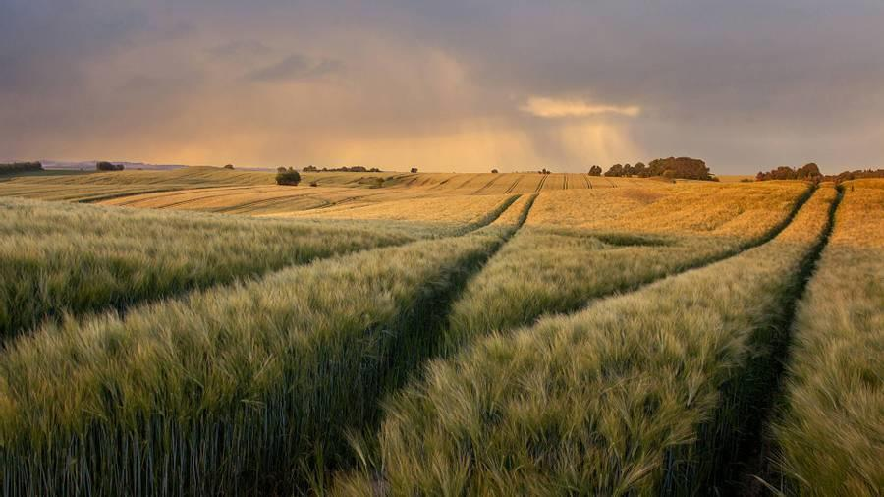
Domain: AGRICULTURE
Problem Statement: Estimation Of Crop Yield Based On Seed Quality

Slide 3
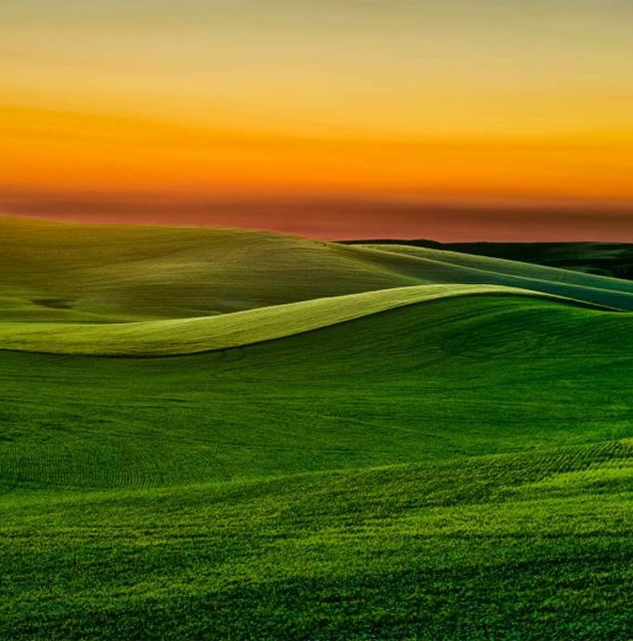
abstract
Agriculture is the backbone of India playing a vital role in economy. The Key factors which affect production of crop includes soil ingredients(N,P,K), quality of seed, weather conditions(like temperature, humidity, rainfall).After many background studies, we are here with a model which helps to get better profits. This model is built using machine learning and few python algorithms. By this model, a clear information is achieved regarding types of fertilizers, average field, expected Market prices, alerts through phone calls. This helps farmers to analyze and take precautionary measures return help in gaining profits. Using algorithms helps us to provide data with good accuracy.
​

Slide 4
IDEA
From the Problem Statement we chose. Here we come up with an idea—
From the User we indirectly get three inputs, they are:
1. Seed Quality
2. Fertility of Land
3. Landscape
SEED QUALITY:
To let us know the seed quality, we provide an option for the user to Choose the Crop to be grown and the Certification tag Colour on the seeds packet.
From that we get to know the purity of the seeds being used for the crop.
FERTILITY OF LAND:
We can get this information in 2 ways:
1. Getting Pre-Existing data(if the fertility test has already done) directly
from the user as the input.
2. Book a fertility test for the soil and we act as intermediate between the
user and the fertility test center and trace the information from the
center.

Slide 5
LANDSCAPE:
We ask the user to enter the Survey Number of the user’s land, from the survey number we get to know the area of cultivation and location so that we can trace the weather conditions.
With all the inputs received from the user.. We proceed to the next stage—>
STAGE-1:
From the results of the Fertility Test, we get the details such as
1. pH of the soil.
2. Amount of nutrients(N,P,K) present in the soil.
By fetching the data mentioned above including landscape we suggest the users the
fertilizers to be used along with quantity for better production.
STAGE-2:
As we know the location and the crop being cultivated, we compare those with the weather patterns of the area and suggest the user with the right time for cultivation.
STAGE-3:
If the user wants to get additional benefits like alerts on change in weather conditions that might cause damage to the crop, we install IoT sensors in their fields.
From the signals traced through the IoT sensors, we send alerts to the users through a recorded phone call.

Slide 6
STAGE-4:
The information from landscape details helps to acquire results such as:
1. Average Yield(q/ha)
2. Average Selling Price(Rs./q)
3. Gross Returns(Rs./ha)
As we know the seeds being used by the farmers and the fertilizers(as we are suggesting it), we can approximately estimate the amount of expenditure spent by the user on the crop and compare it with the Selling price(based on the MSP) and the user can Analyze The Profits.

Slide 7
How we analyze profits?
To know about Profits, we have to first know about:
Investment
Returns
Farmers invest in farming in the form of Seeds and Fertilizers.
IMPLEMENTATION DETAILS:
As Farmer enters details of his land and seed quality.
We Estimate the investment in seeds as follows:
We assume the worst case that is 60kg of seeds/hectare, using this we can calculate the total quantity of seeds(60*area(in ha)) used in kg.
And we know cost of the seeds depend on purity, which is taken from the government source and can calculate the amount spent on seeds.(Cost of 1 kg*Total quantity of seeds).
We can Estimate the investment in fertilizers as follows:
As we know the N,P,K and pH values and the Crop, we can know
the fertilizers that are needed to be used for the better yield in
Quantity along with the Cost.
Along with this farmer also has some additional investments.(like labor charge, water resources..)
​

Slide 8
How we analyze profits?
We estimate the returns of the farmer based on MSP(provided by the government) and the Quality of seed used by him.
Now, we are with the Investments and the Returns, we can analyse his profits as follows
PROFIT = (RETURNS-INVESTMENT)
​

Slide 9
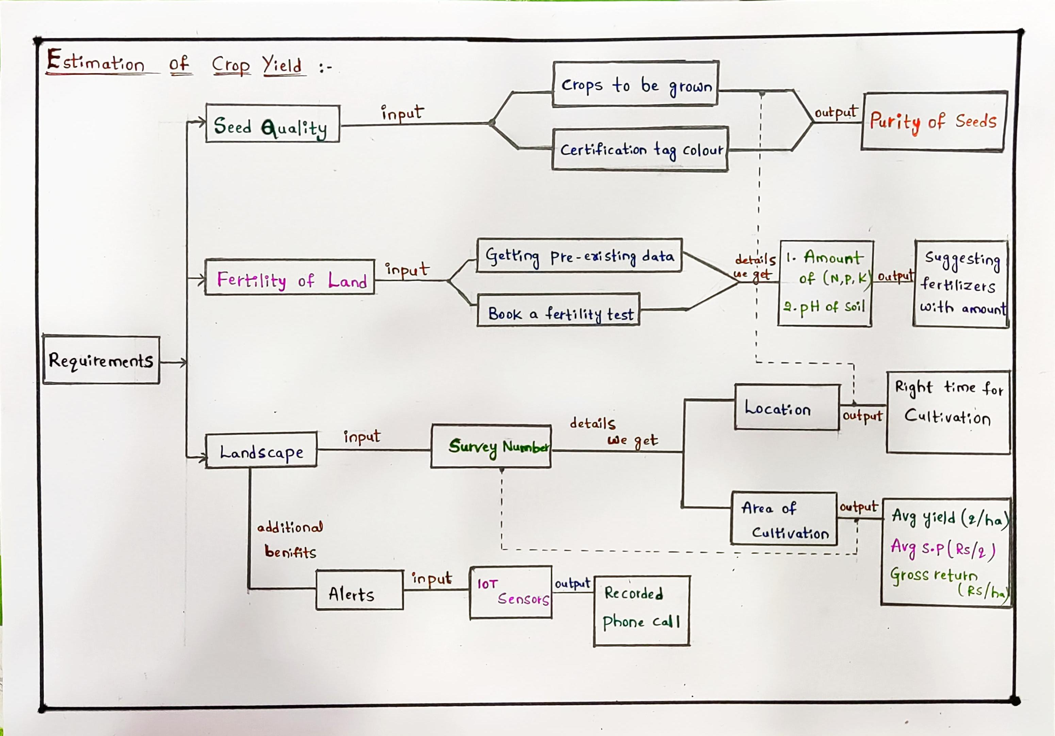
FLOWCHART

Slide 10
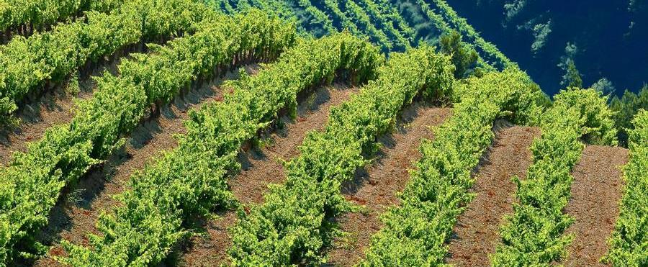
Motivation
The current scenario of farmers are adverse in India. The real time scenario of farmers motivated us to choose the problem statement. Being AIML students, we chose machine learning and python algorithms for developing the model for given problem statement and benefit the farmers with profits.

Slide 11
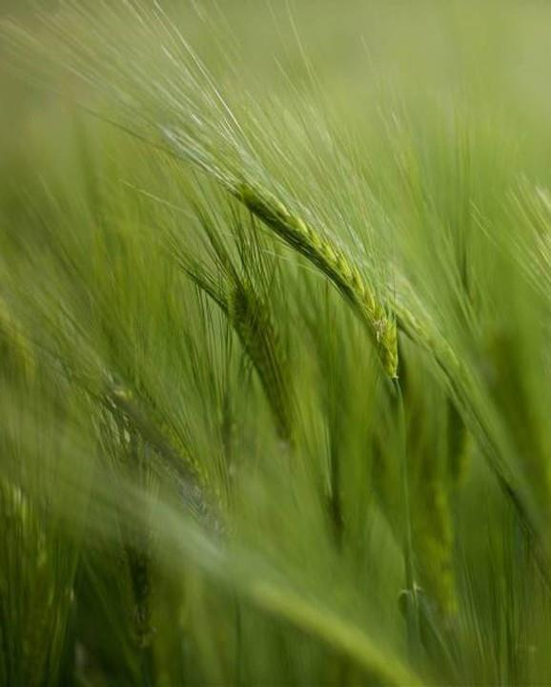
Objective and scope of solution
​
OBJECTIVE:
Using machine learning and python algorithms to predict the crop yield.
To benefit the farmers suggesting right time for cultivation, fertilizers, sending alert messages.
SCOPE OF SOLUTION:
This model is user friendly and easy to understand by the user.
Helps in benefiting the farmers with better profits.
Using the other high efficient algorithms helps to enhance the efficiency of system in future.

Slide 12
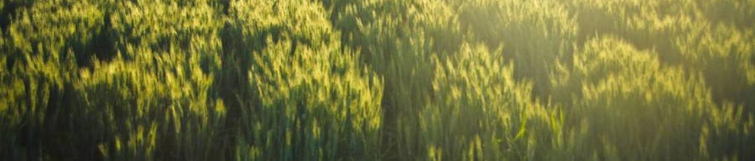
Resources required
Machine Learning
Python Algorithms
IoT Sensors

Slide 13
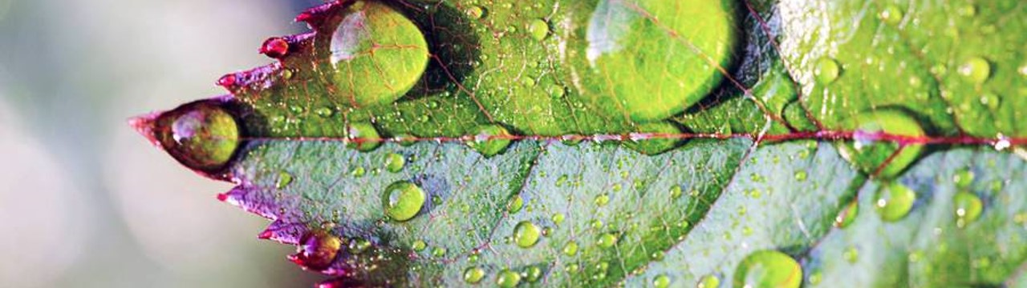
☺
“Farming looks mighty easy when your plow is a pencil and you’re a thousand miles from the corn field”
Thank you

